Slide 1
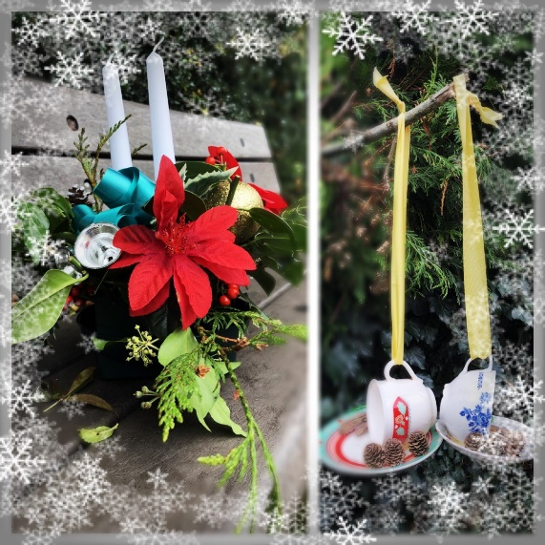
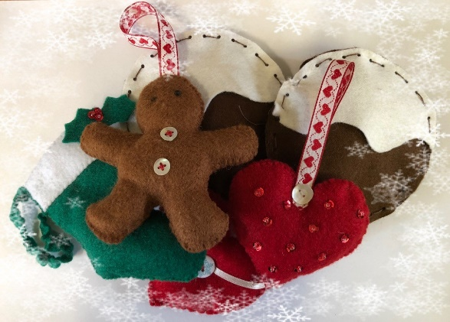
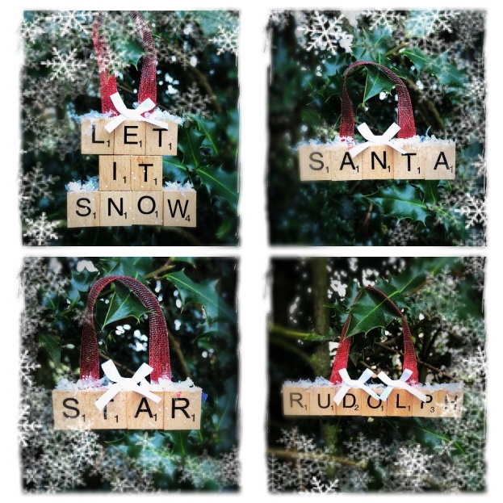
Dear WSAPC Staff,
WSAPC CRAWLEY are holding a Mini Christmas Fair on Wednesday 28th November 2018 from 13.30 – 15.00 to which all are welcome.
This year, marks the first year of an Enterprise Project at our school, the staff are extremely proud of the ideas, work and effort that the students have put in. We want to showcase their amazing work and get them some sales to encourage them to broaden their horizons for future Enterprise Projects!
The Enterprise theme is Christmas Decorations (please see photo’s of the actual products), the items that will be on sale have been created by :
“Wishing Someone A Perfect Christmas”
“Jarrin Christmas Crafts”
“Scrabble my Decs”
Please note : The table decorations/wreaths will be made to order and delivered. The Scrabble Decorations can also be personalised, made and delivered to you before the 19th December 2018. All handmade items will be selling at under £5.
REFRESHMENTS WILL ALSO BE AVAILABLE
At the students request a percentage of their profit will be donated to the local charity St Catherine’s Hospice.
We look forward to welcoming you all but understand that you all lead busy lives so if you are tempted by any of our products but can’t make it , please email cpru@area-c-pru.w-sussex.sch.uk for more details and prices. We would be happy to arrange a suitable time for collection.

